Slide 1
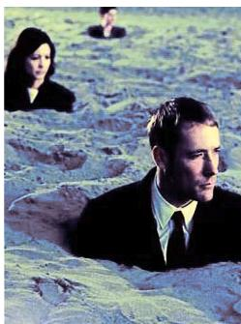
HOME DUST - THE ENEMY OF HEALTH
45 KG/YEAR
1 GR = 700,000,000 PARTICLES
31,500,000,000,000
ENEMIES YOU DON’T SEE
8

Slide 2
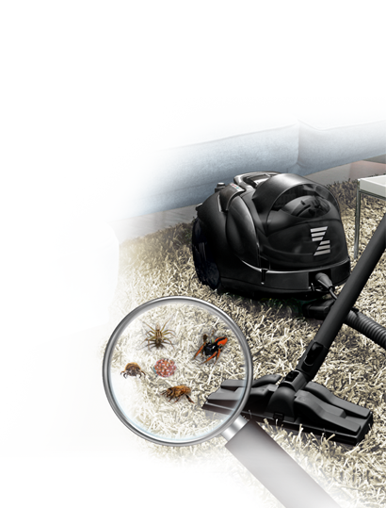
ALLERGENS IN HOME: MITES
FLOORS, FURNITURE, CARPETS
1 GR DUST = 19,000 MITES
1 MATTRESS =
UP TO 10,000,000 MITES
CAN BE KILLED ONLY BY STEAM
9

Slide 3
ASTHMA
DANGEROUS CHRONIC DISEASE
300+ MILLION PEOPLE IN WORLD
400.000+ DEATHS ANNUALY
250.000+ AVOIDABLE DEATHS ANNUALY
Triggers: dust, mites, chemicals, pollen…

Slide 4
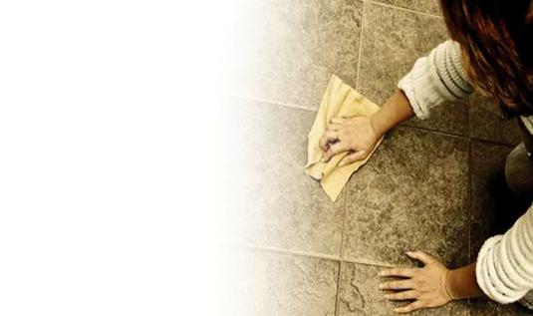
CLEANING THE TRADITIONAL WAY
CHEMICALS RESPONSIBLE
FOR 15% OF ASTHMA
MOPS, CLOTHS & SPONGES
ARE IDEAL AS BACTERIA HABITATS
VACUUMING CIRCULATES DUST

Slide 5
…ZEPTER has a solution…!

Slide 7
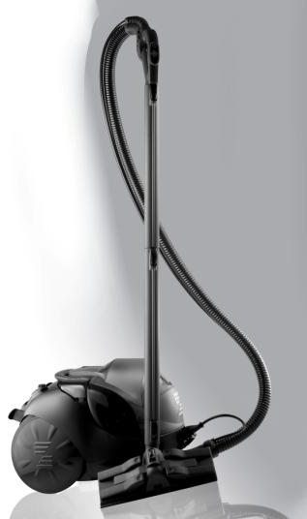
TUTTOLUXO 6SB
COMPLETE CLEANING SYSTEM BY ZEPTER
Natural steam power
Stylish Italian design
Unrivalled quality
Charismatic intelligence
YOUR UPGRADED AND TUNED
SECRET WEAPON OF SUCCESSS!

Slide 8
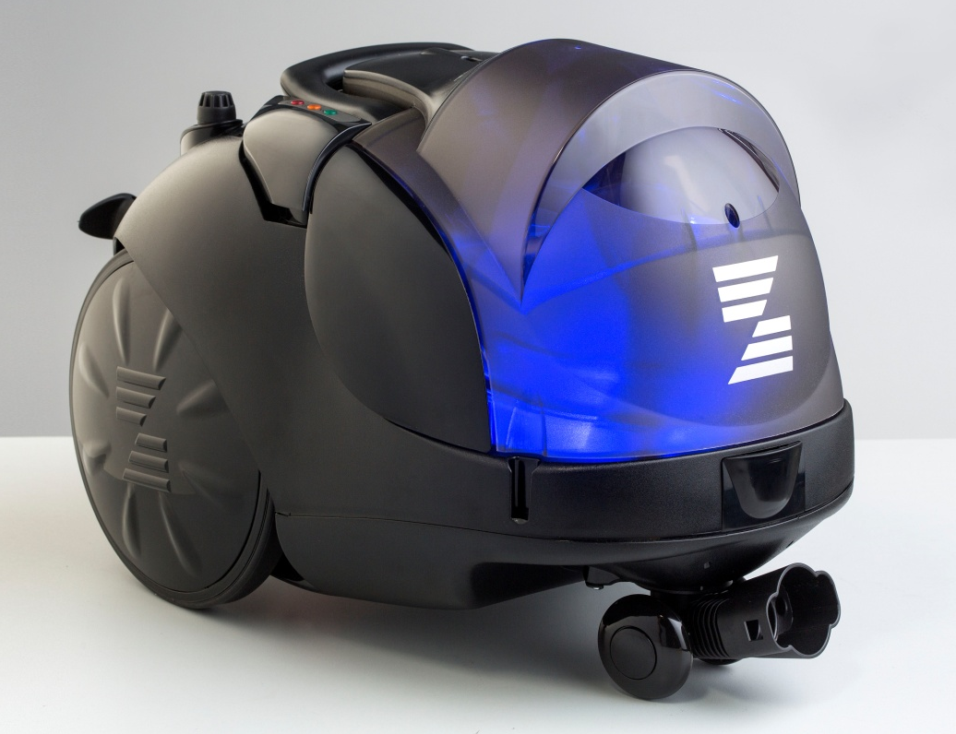
6 DEVICES IN ONE
6 UNIQUE FUNCTIONS
3 PATENTED SYSTEMS

Slide 9
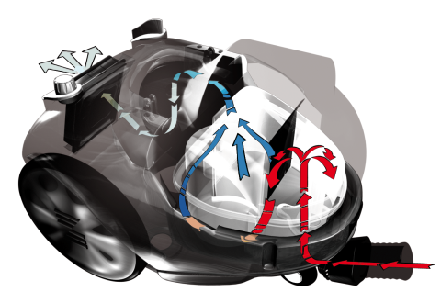
1. SPRAY SYSTEMTM
Sophisticated system of filtration.
Nebulized water that captures even finest particles.
Environmentally aware filter system – no more paper
bags and various filters.
Mutli-filtration system saves your pocket
4

Slide 10
2. SLALOM SYSTEMTM
Easy to handle and move.
Maximum freedom of movement.
Small front wheels and hose.
No damage to hose or machine.

Slide 11
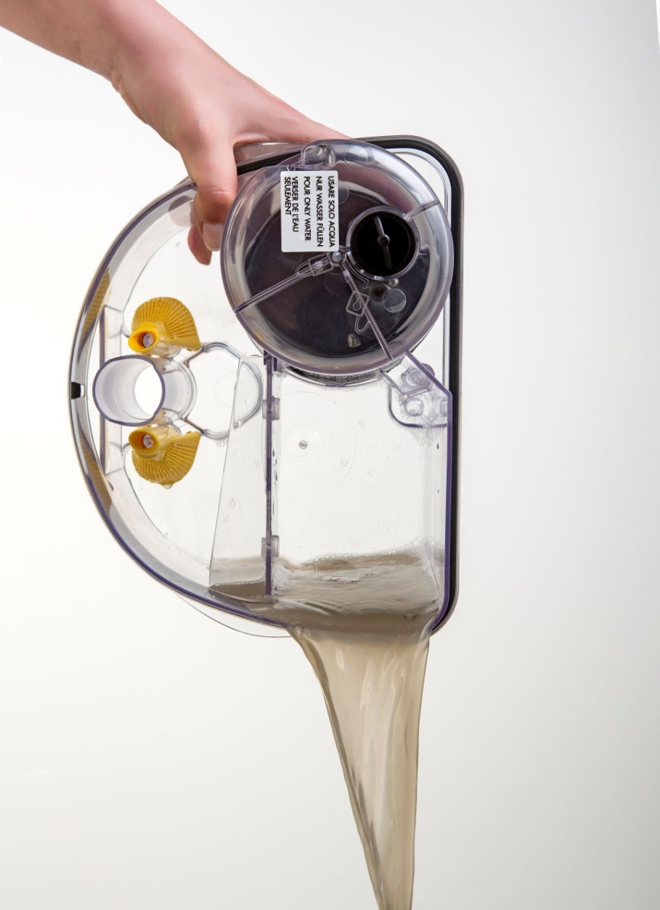
3. SIMPLY SYSTEMTM
Easy as 1-2-3.
Empty the water tank.
Rinse the tank and parts.
Put back together.

Slide 12
FUNCTIONS
TUTTOLUXO 6S
DOES IT SIX TIMES BETTER THAN ANYONE ELSE
1
VACUUMING - WET & DRY WITH WATER FILTER
2
STEAM CLEANING & DISINFECTION
3
STEAM CLEANING & VACUUMING CLEANING
4
PROFESSIONAL STEAM IRONING AT HOME
5
AIR CLEANING & AIR AROMA THERAPY
6
AIR HUMIDIFICATION & AIR INFUSION

Slide 13
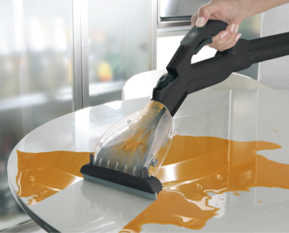
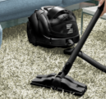
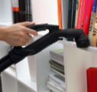
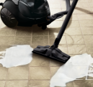
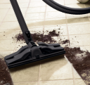
VACUUMING - WET
& DRY WITH WATER FILTER
Up to 1.2 litres / safety float
Uses water in the water tank
(except when vacuuming liquids)
Bye-bye Bacteria, protects your health
Easy to maintain: empty the water
tank and rinse

Slide 14
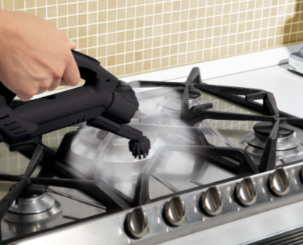
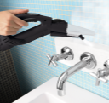
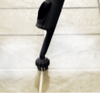
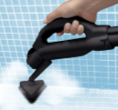
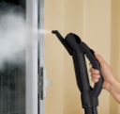
STEAM CLEANING & DISINFECTION
Powerful grease-remover and excellent dissolver
Pure cleanliness – no more
use of chemicals; saves you a lot of money
Easy use – operated from the handle
Steady, powerful steam at approximately
150°C
Your home – Oasis of health:
steam kills all mites, bacteria and viruses

Slide 15
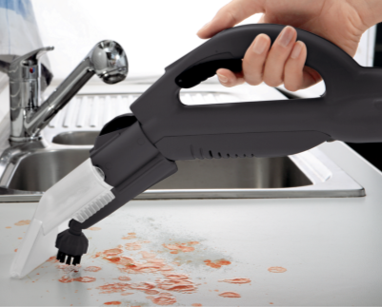
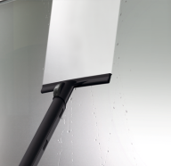
STEAM CLEANING & VACUUMING CLEANING AT THE SAME TIME
2 tasks per one action
Guarantees complete cleaning

Slide 16
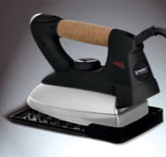
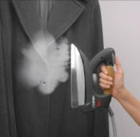
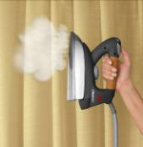
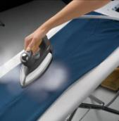
PROFESSIONAL STEAM IRONING AT HOME
Powerful professional
steam pressure!
Simultaneous ironing of several layers
Ironing of hanging pieces - Vertical ironing!
Eliminating bad-odours from clothes

Slide 17
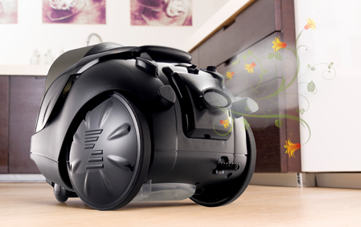
AIR CLEANING &
AIR AROMA THERAPY
Enhances quality of air.
Sets right atmosphere.
To be used with Zepter
Cosmetics Aroma Liquids.

Slide 18
BENEFITS
Health:
Disinfects, traps microscopic dust and bacteria
Multilevel filtration
Allergy and asthma prevention
Dust is not swirled anymore but stays in a water filter
Spores from mould and mould itself being destroyed by steam
No use of chemicals anymore! No breathing of vapours from chemical detergents anymore!
COMPLEX PREVENTION VS. ALLERGY AND ASTHMA!
l

Slide 19
BENEFITS
Time:
Average time spent by cleaning per family is 6 hours per week
Use of Tuttoluxo 6SB saves 50% of your time (3 hours per week) spent by cleaning!
Spent gained extra time with your family or by your hobbies!
WE WILL NEVER GET OUR TIME BACK!
TIME IS THE MOST PRECIOUS COMMODITY!
DO NOT WASTE YOUR TIME BY CLEANING!

Slide 20
BENEFITS
Money:
No money spent on chemical detergents anymore!
No money spent on paper dust bags anymore!
Time is money!
How do you worth 1 hour of your life?
For how much would you buy 1 extra hour of your life?
Save at least 12 hours per month! = 6 days per year!
Do your own calculation!

Slide 21
